Slide 1
Restaurant Management App

Slide 2
outline
Our Team
Overview
Targeted Users
Importance and Expansion
Diagram
Implementation
Live Demo

Slide 3



OUR TEAM
John Chapple
ALEX VARENHORST
JORDAN GREENE

Slide 4






Project overview
Restaurants using similar software
Online management application that will allow managers and employees access to different aspects of the business.
Checking Hours, Change User Information, View Online Bulletin Board

Slide 5

Targeted Users
The intended users of the application would include restaurants that are looking for a way to manage their business, being able to see their employees as well as up to date analytics to better understand how their business is operating.
The intended users of this application would be the restaurant managers and employees.

Slide 6
Importance and Expansion
One of the benefits of an application like ours is having multiple facets of the business all in one location. Being able to see your entire staff list as well as being able to communicate with staff through the bulletin board is great to have all together so you don’t have to juggle all those types of things with various apps.
When it comes to expanding, we plan on adding in different analytics to be able to see up to date information all in one place. You can see who your top sellers are as well as being able to have a forecast for inventory so you can accurately order next months inventory.

Slide 7
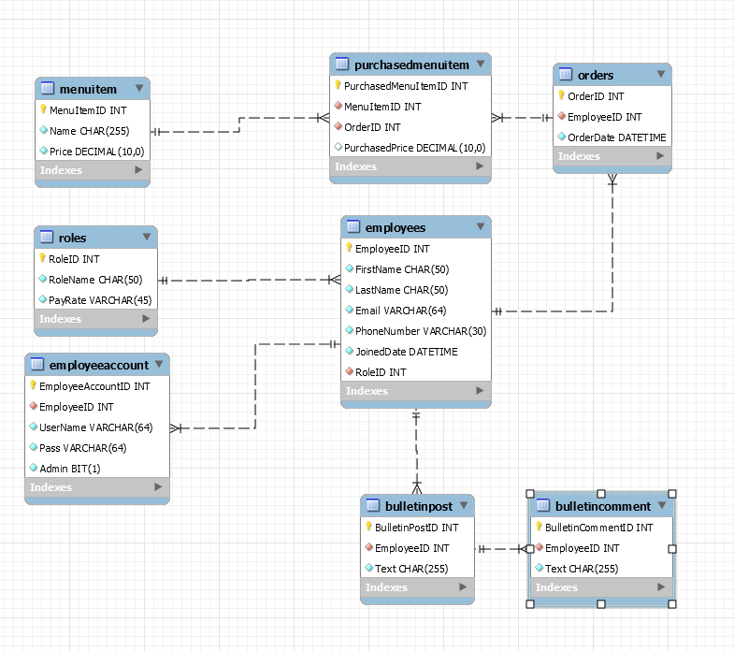

Slide 8
implementation
STAGE 01
Designed a database flow chart and discussed the coding elements we wanted to use when it came to the application.
Started building the front-end of the application using Node.js and Vue.js
STAGE 03
Started building the back-end and database of the application using Node and MySQL. Then generating data for our application to use.
STAGE 02
STAGE 04
STAGE 05
Connecting the front- end to the back-end. Then testing for common errors and making it demo ready.
Continue working on application to incorporate business analytics and basic inventory management.

